Slide 1
Softwere Development Project
Online bus pass

Slide 2
Tital of project: Online bus pass
BY :- Samarth Saudagar Takbhate
Div: P Roll no: 69
GR no: 11910739

Slide 3
Introduction:
This Application is mainly aims to give an effective facility of online bus pass system.
This system will include web application to access user’s account.

Slide 4
Project description:
User login module
User registration module
Display unique QR code module
New bus pass module

Slide 5
Tools and software:
Python.
Tkinter library.
Pycharm software.

Slide 6
Main window:
Main window contain two options
First one is sign in feature for user. i.e. The user can login here by giving correct username and password from which they are registered. An invalid login message is displayed when the user is not recognized by system
Second is sign up feature for user. i.e. The new users can register for the online bus pass here. The user has to give a username and password.

Slide 7
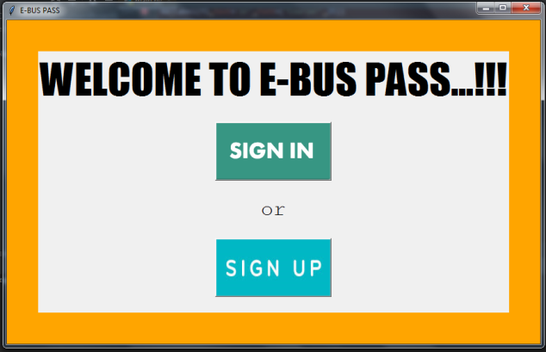
Main window:

Slide 8
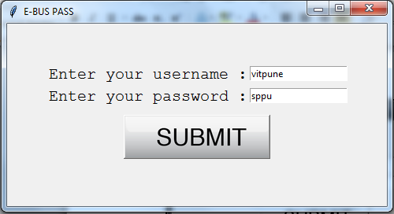
Registration module:

Slide 9
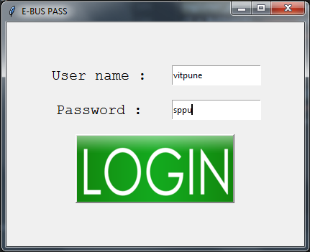
Login module:

Slide 10
File handling:
It is basically used to store a large amount of data in an ordered way such that the user will be allowed to access the data and make changes if any in a simpler and convenient manner.
Opening a file:
file_object = open(filename [,mode])
Ex: r- read only, w-write, b-binary, t-text, +- read and write, a-append
Closing a file:
file_object.close()

Slide 11
First window:
It is containing of two options :
1) My QR code
2) Get a e-pass
1. By clicking on My QR code , a QR code will be displayed which is unique for a single user. The conductor will scan the QR code , and status of pass will be displayed on screen.
2.By clicking on Get a e-pass, user will get a new window displaying a certain input boxes,which are asking for the passengers detail for the QR code .

Slide 12
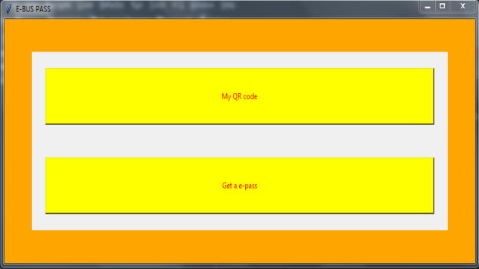
First window:

Slide 13
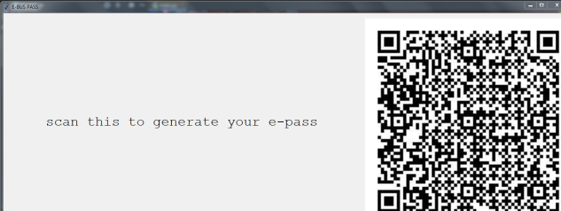
Displaying of qr code:

Slide 14
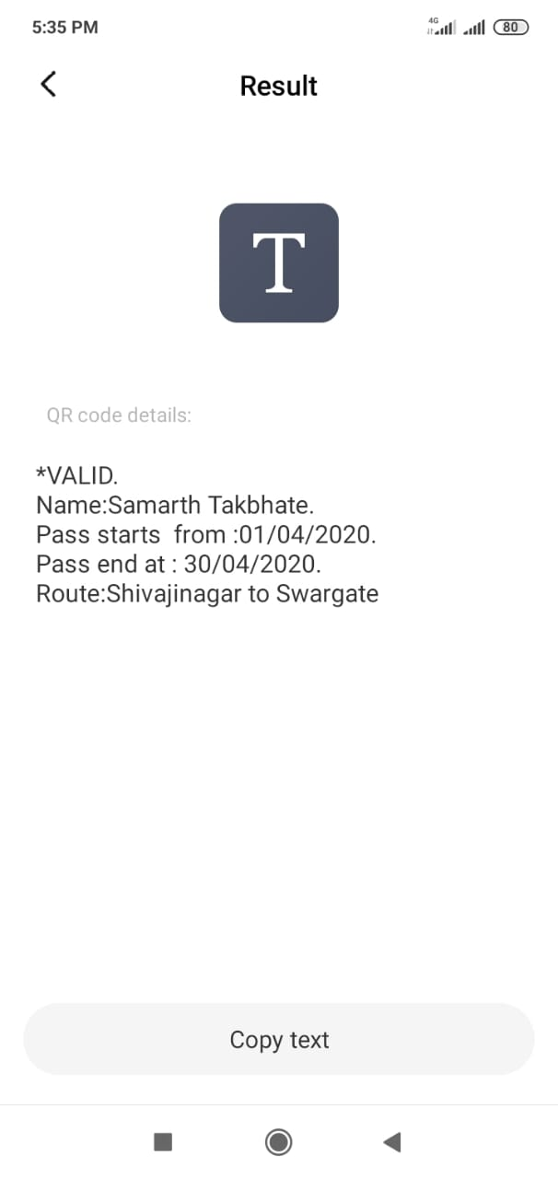
After scaning QR code:

Slide 15
Future scope:
The payment can be done online via credit or debit card.
smart card instead of taking print out of pass.
An android application can be developed which could be accessible to every individual so that he/she can get bus pass easily.
GPS tracking to the nearby buses to get updated imformation.

Slide 16
Conclution:
It can be summarised that bus pass is a very important task which could be made easier using this web application.
It’ll be user friendly and flexible application for online bus pass.
It is a real time project which is useful for the public who are facing problems with the current manual work of bus pass.

Slide 17
Thank you!!!

